Slide 1
Operating system and system programming (25CS2104E)
TITLE
Review-I
Under the Esteemed Guidance of
Raghupathi M
CSE Department
Team Members:
2520090149-Sai Snehith
2520090114-Harshith Reddy
2520090122-Rithesh

Slide 2
Contents
Abstract
Introduction
Hardware and Software requirements
System Architecture
Conclusion

Slide 3
Abstract
The Linux Memory-Mapped File Management System is designed to demonstrate efficient file access using memory mapping in Linux. Instead of repeatedly transferring data using read() and write(), the project uses the mmap() system call to map file contents directly into a process's virtual address space.
The system supports file creation, opening, mapping, reading, modification, synchronization, resizing, and unmapping. It demonstrates important Operating Systems concepts such as virtual memory, process address space, file I/O, memory mapping, and Linux system calls.
The project provides a practical understanding of how file-backed memory interacts with the operating system and persistent storage.

Slide 4
Introduction
Traditional file handling uses system calls such as read() and write().
Frequent file operations can cause additional system-call and data-transfer overhead.
Memory mapping allows a file to be mapped directly into a process's virtual address space.
The program can access and modify file contents through normal memory operations.
mmap() is used to create the memory mapping.
msync() synchronizes modified memory contents with the file.
munmap() removes the mapping after the operation is completed.
The project demonstrates the relationship between virtual memory, processes, and file storage.

Slide 5
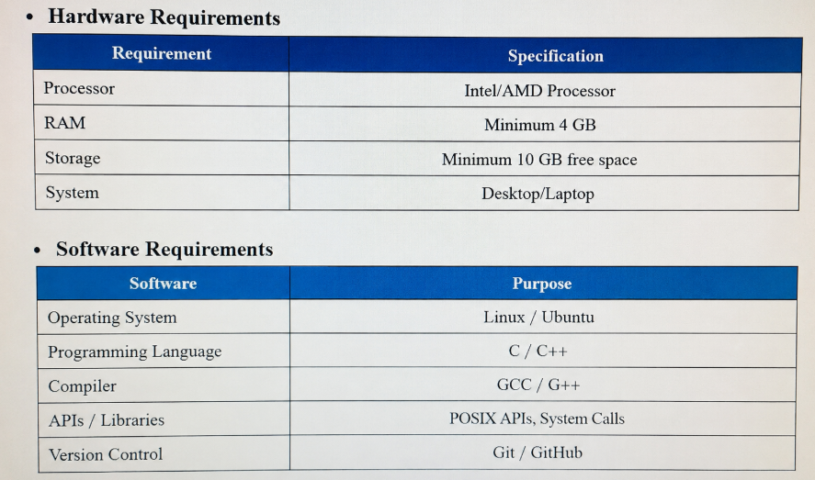
Hardware and Software requirements

Slide 6
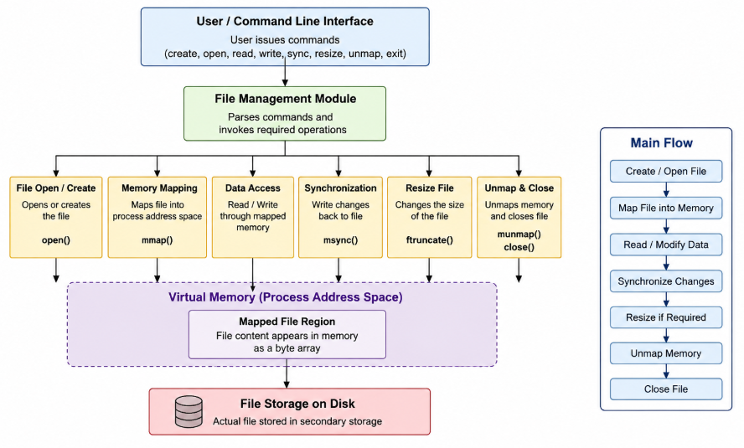
System Architecture

Slide 7
Thank you

